Slide 1
Data Visualisation for Reviews
Presented By:
Gourav Pratap

Slide 2
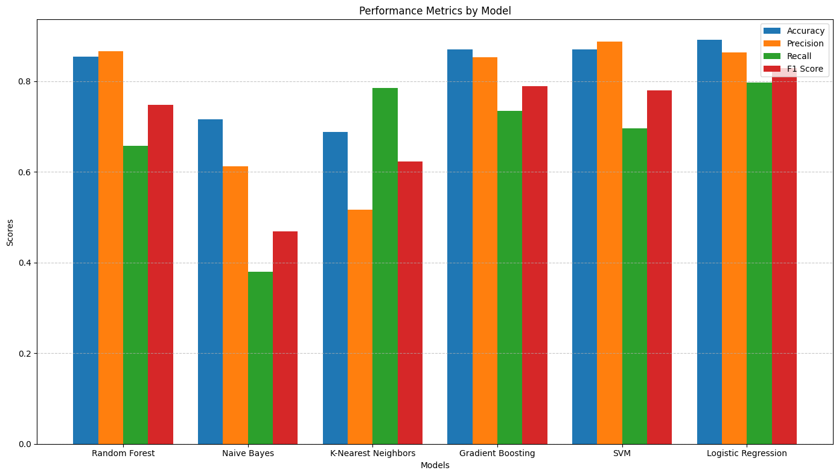
Accuracy, Precision, F1 Score and Recall for the models prepared

